Slide 1

Algorithm Analysis IT-2101
Dr. Mohammad Abu Yousuf
yousuf@juniv.edu

Slide 2
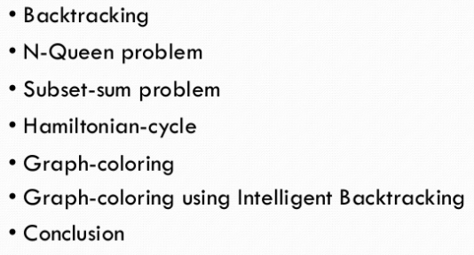
Introduction
Contents:

Slide 3
What is Back­track­ing Programming?
Recur­sion is the key in back­track­ing pro­gram­ming. As the name sug­gests we back­track to find the solu­tion.
We start with one pos­si­ble move out of many avail­able moves and try to solve the prob­lem if we are able to solve the prob­lem with the selected move then we will print the solu­tion else we will back­track and select some other move and try to solve it.
If none if the moves work out we will claim that there is no solu­tion for the problem.

Slide 4
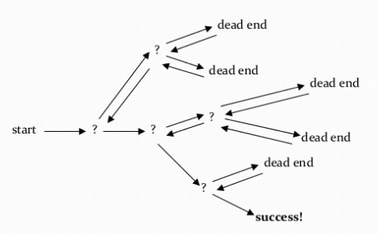
What is Back­track­ing Programming?

Slide 5
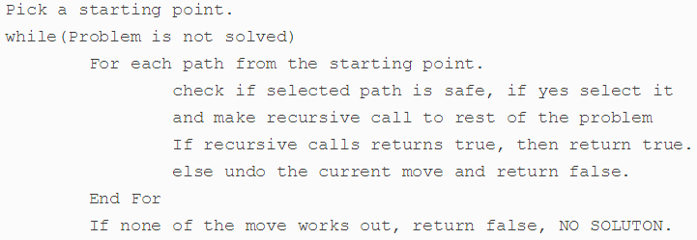
Gen­er­al­ized Algorithm

Slide 6
N-Queen Problem
Objec­tive : In chess, a queen can move as far as she pleases, hor­i­zon­tally, ver­ti­cally, or diag­o­nally. A chess board has 8 rows and 8 columns. The stan­dard 8 by 8 Queen’s prob­lem asks how to place 8 queens on an ordi­nary chess board so that none of them can hit any other in one move.

Slide 7
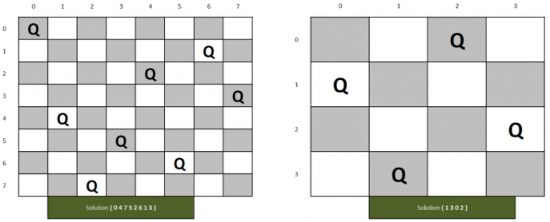
N-Queen Problem

Slide 8
N-Queen Problem
The idea is to place queens one by one in different columns, starting from the leftmost column.
When we place a queen in a column, we check for clashes with already placed queens.
In the current column, if we find a row for which there is no clash, we mark this row and column as part of the solution.
If we do not find such a row due to clashes then we backtrack and return false.

Slide 9
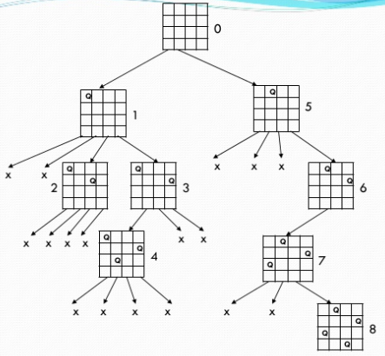
N-Queen Problem (4 Queen)

Slide 10
N-Queen Problem
The backtracking strategy is as follows:
Place a queen on the first available square in row 1.
Move onto the next row, placing a queen on the first available square there (that doesn't conflict with the previously placed queens).
Continue in this fashion until either:
you have solved the problem, or
you get stuck.
When you get stuck, remove the queens that got you there, until you get to a row where there is another valid square to try.

Slide 11
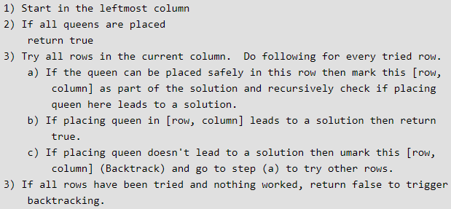
N-Queen Problem

Slide 12
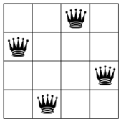
4-Queen Problem
The 4-Queens Problem consists in placing four queens on a 4 x 4 chessboard so that no two queens can capture each other. That is, no two queens are allowed to be placed on the same row, the same column or the same diagonal.

Slide 13
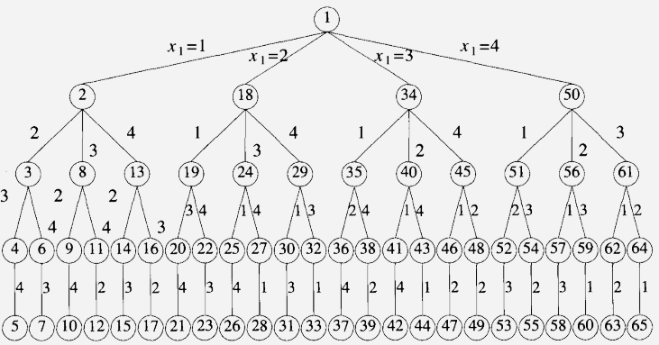
Tree organization of the 4-queen solution space

Slide 14
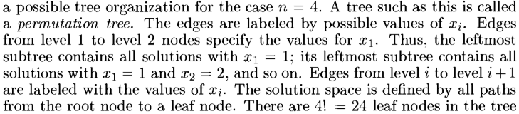
Tree organization of the 4-queen solution space

Slide 15
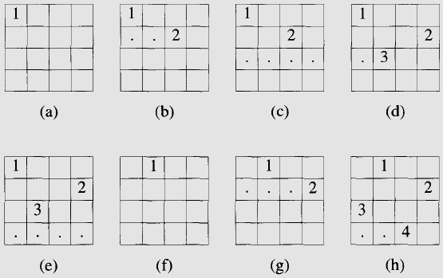
Back tracking solution for the 4-queen problem

Slide 16
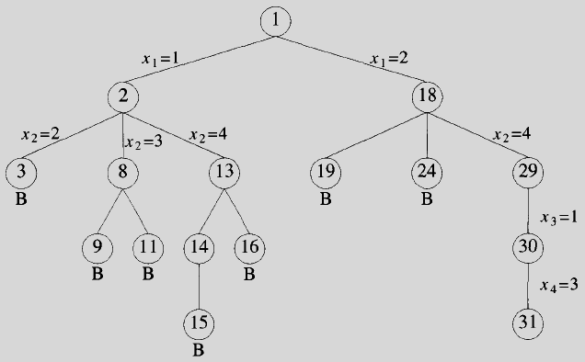
Portion of the tree that is generated during backtracking

Slide 17
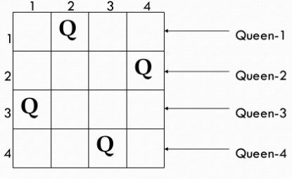
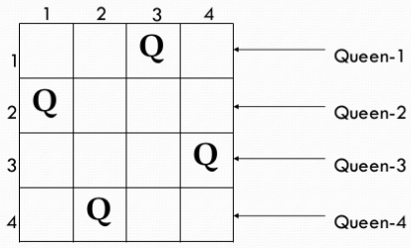
Two solutions of 4 Queen Problem

Slide 18
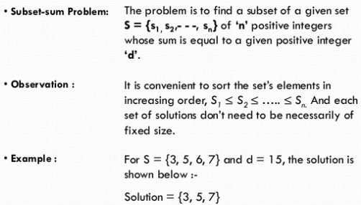
Subset Sum Problem

Slide 19
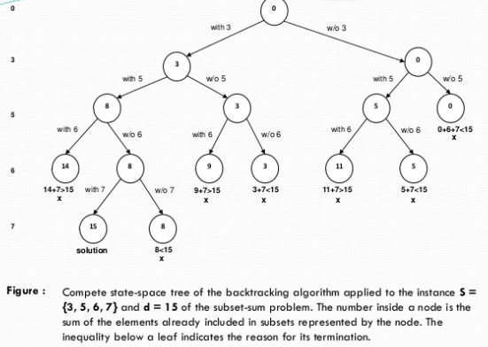
Subset Sum Problem

Slide 20
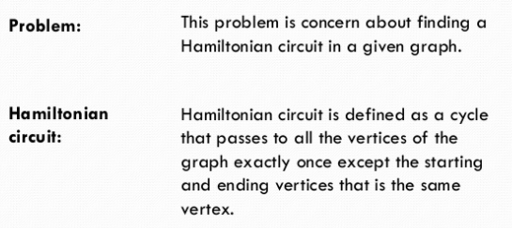
Hamiltonian circuit problem

Slide 21
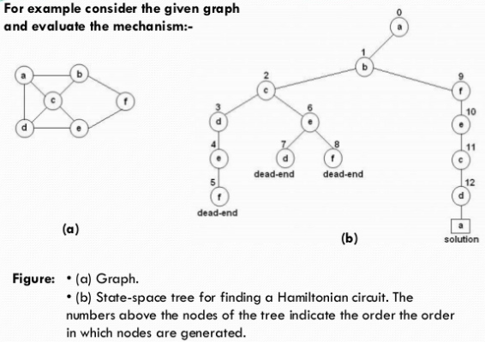
Hamiltonian circuit problem

Slide 22
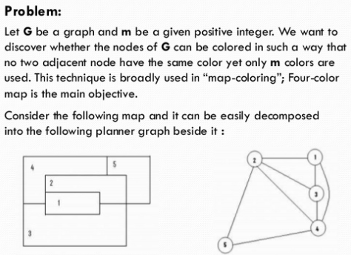
Graph Coloring Problem

Slide 23
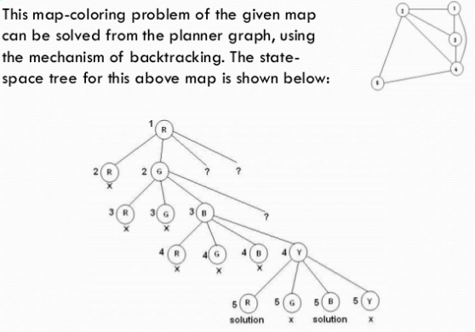
Graph Coloring Problem

Slide 24
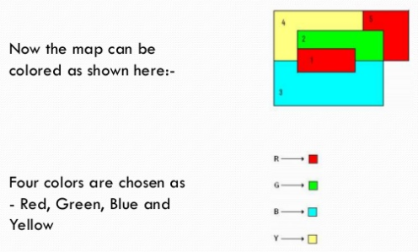
Graph Coloring Problem

Slide 25
Thank you

